Slide 1
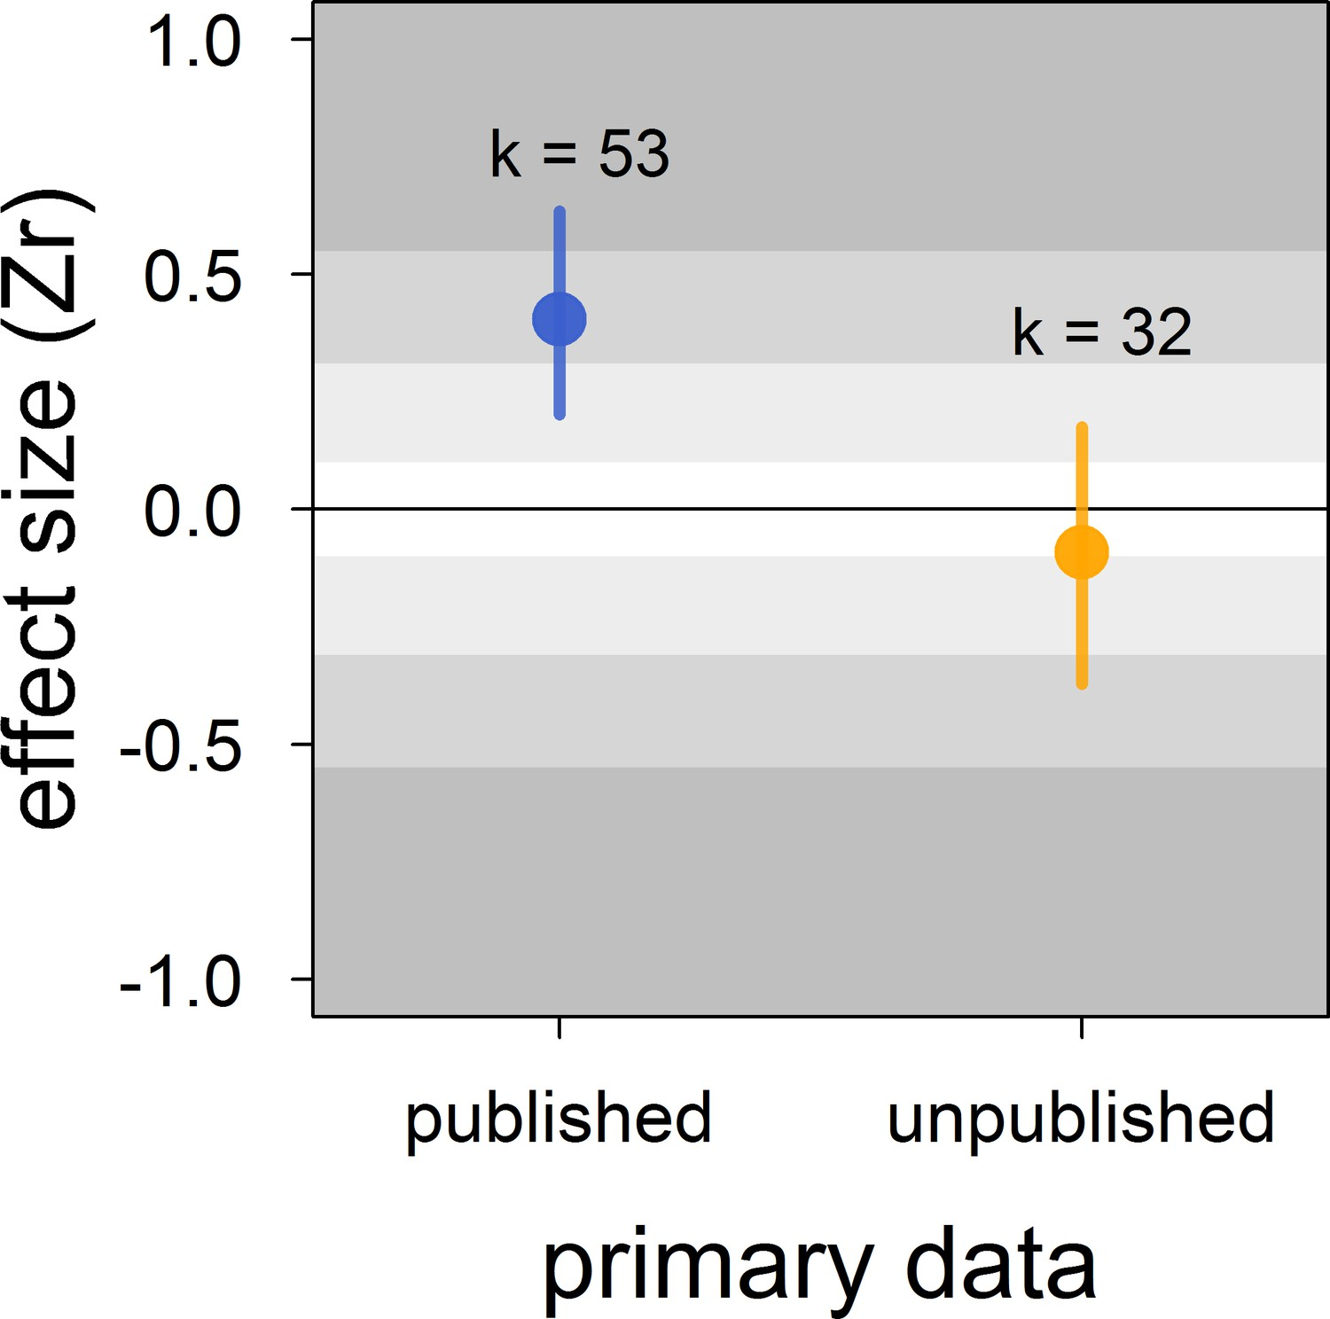
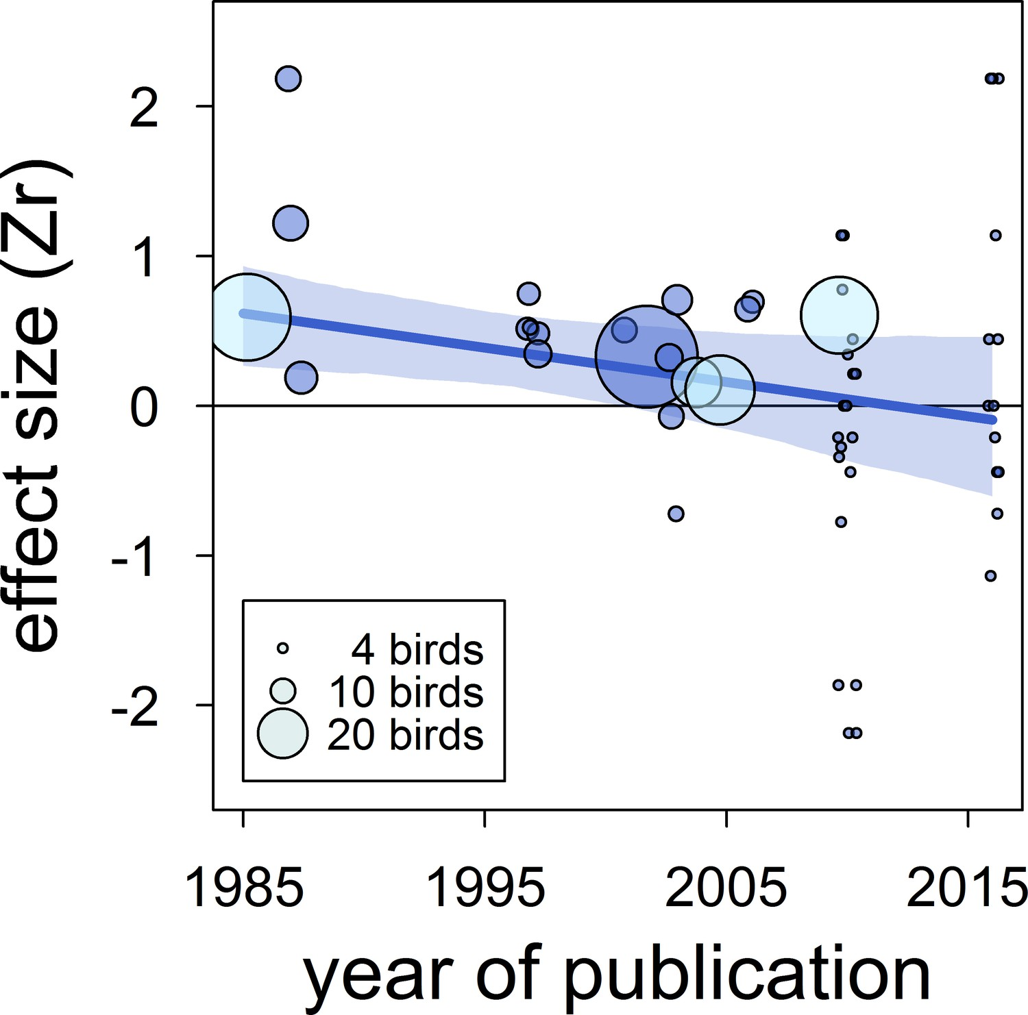
Meta-analysis: Publication biases and what to do about them?

Slide 2
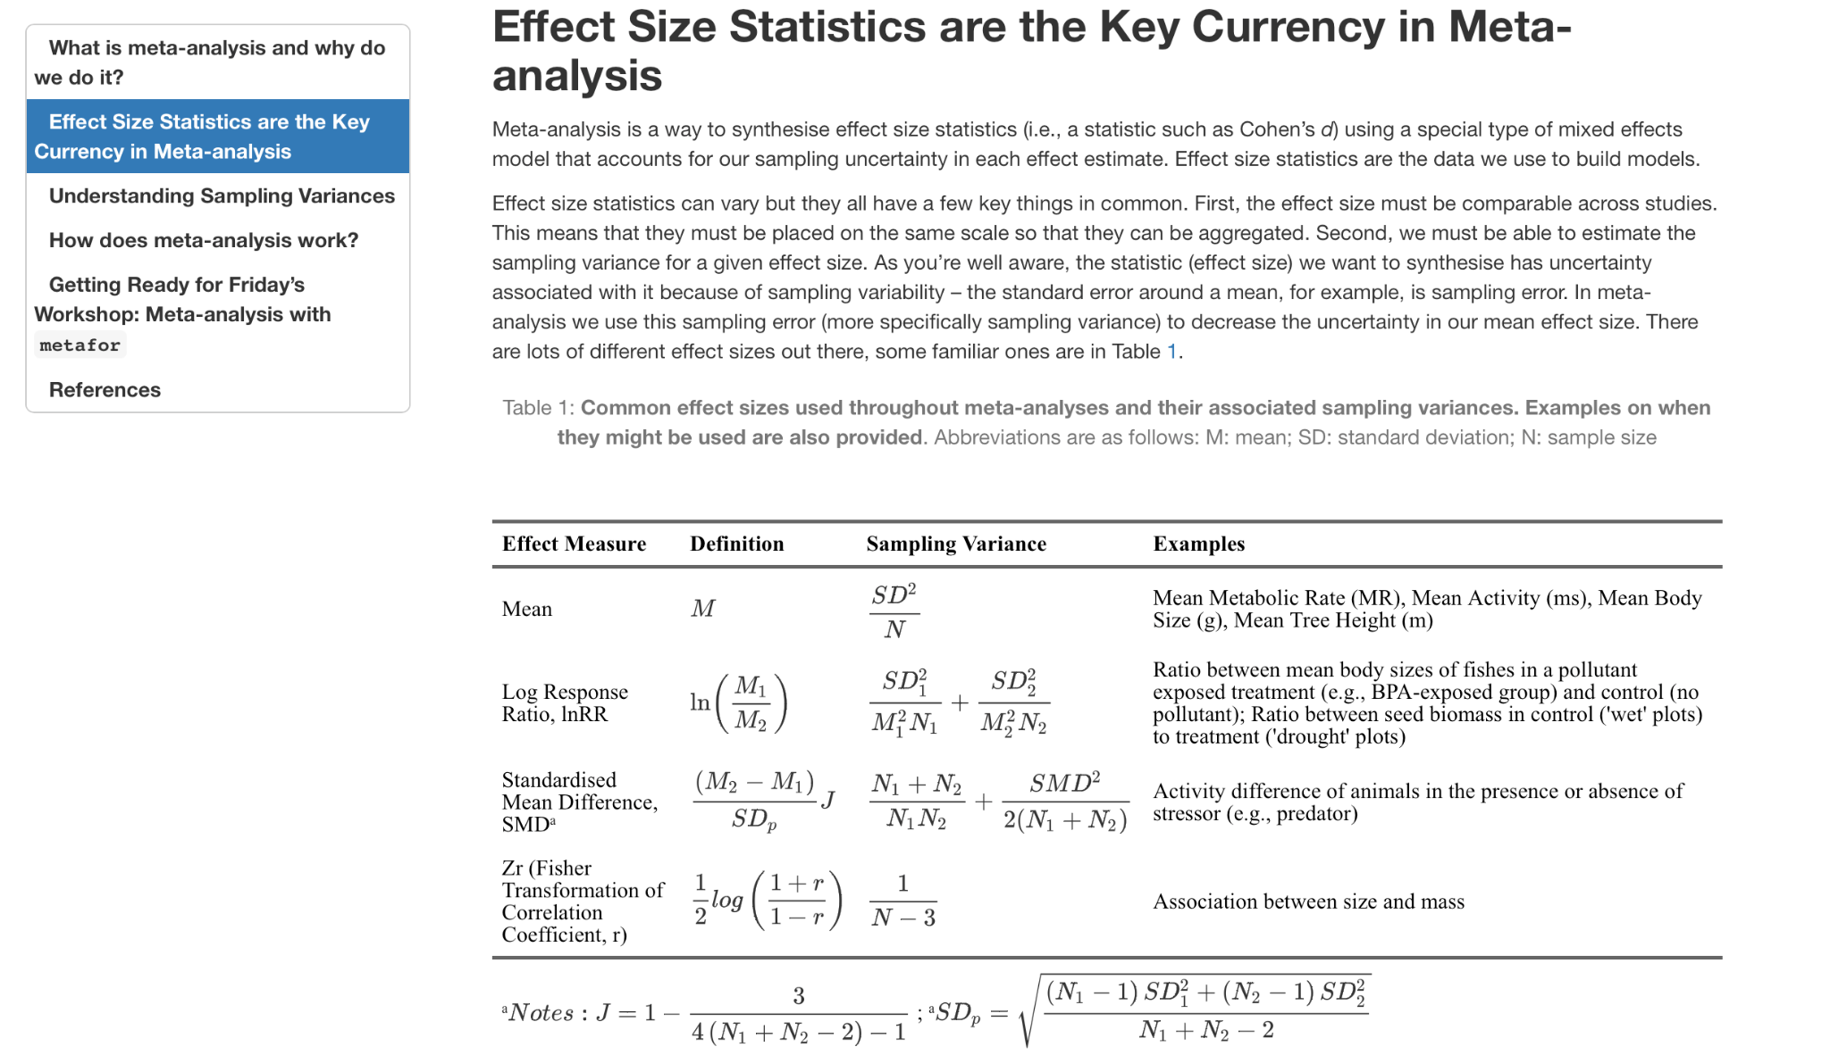
Recap

Slide 3
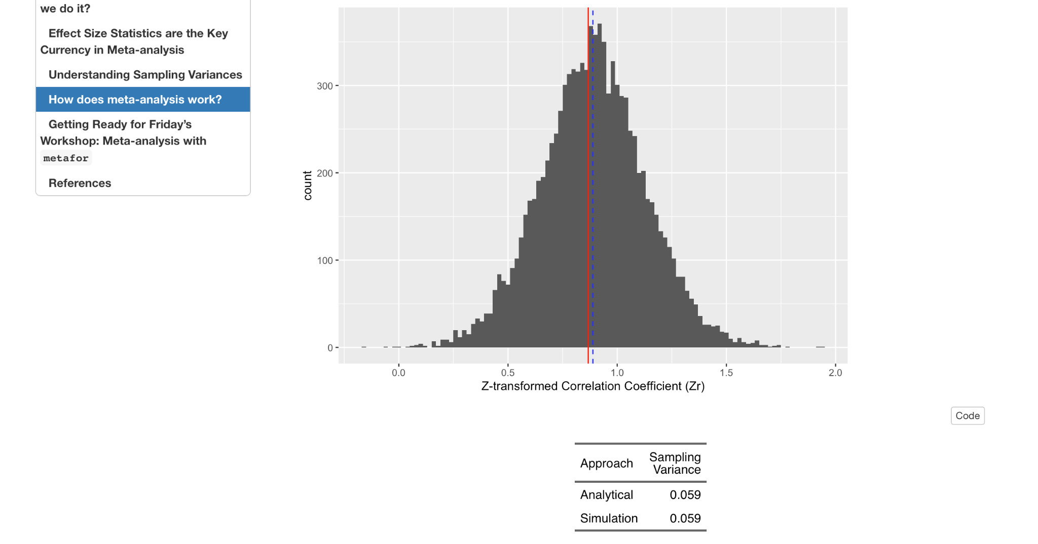
Recap

Slide 4
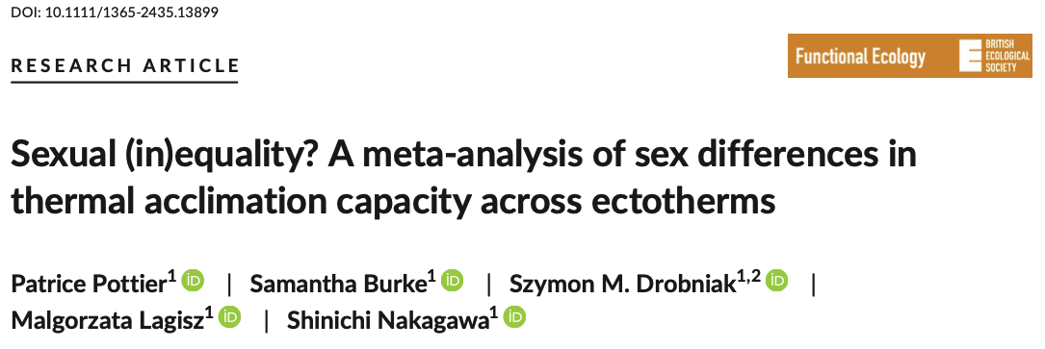



Recap

Slide 5
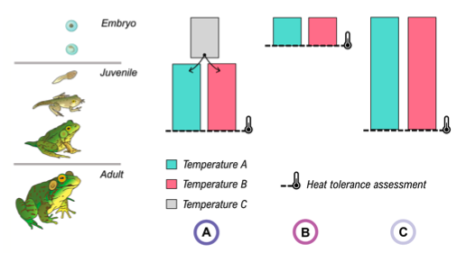
Recap

Slide 6
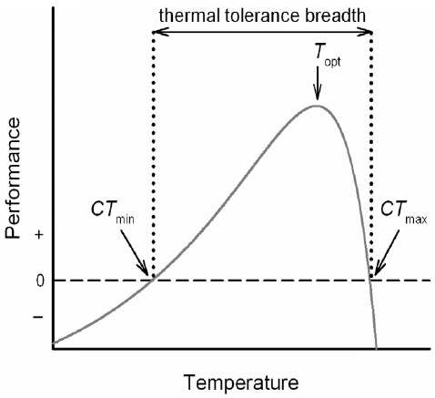
Recap

Slide 7
Recap: Three main aims of meta-analysis
Finding generality across studies on the same (similar) topics
Meta-analysis
Subgroup meta-analysis

Slide 8
Multilevel Meta-analytic Model
1. Meta-Analysis
# Multi-level meta-analytic model MLMA <- metafor::rma.mv(yi= ARR~ 1, V = V_ARR, method="REML", random=list(~1|species_ID, ~1|authors, ~1|es_ID), dfs = "contain", test="t", data=asr_dat) ## Multivariate Meta-Analysis Model (k = 123; method: REML) ## ## Variance Components: ## ## estim sqrt nlvls fixed factor ## sigma^2.1 0.0008 0.0280 29 no species_ID ## sigma^2.2 0.0154 0.1241 21 no authors ## sigma^2.3 0.0097 0.0987 123 no es_ID ## ## Test for Heterogeneity: ## Q(df = 122) = 3941.0055, p-val < .0001 ## ## Model Results: ## ## estimate se tval df pval ci.lb ci.ub ​ ## 0.1668 0.0316 5.2857 20 <.0001 0.1010 0.2327 *** ## ## --- ## Signif. codes: 0 '***' 0.001 '**' 0.01 '*' 0.05 '.' 0.1 ' ' 1
Overall meta-analytic mean as 0.167℃
95% confidence interval of 0.101 to 0.233℃

Slide 9
Recap: Three main aims of meta-analysis
Finding generality across studies on the same (similar) topics
Meta-analysis
Subgroup meta-analysis
Finding consistency (inconsistency) among studies
Heterogeneity analysis

Slide 10
2. Heterogeneity Analysis
I² for multilevel models
#devtools::install_github("daniel1noble/orchaRd", force = TRUE, build_vignettes = TRUE)
library(orchaRd)
orchaRd::i2_ml(MLMA, data = asr_dat)
## I2_Total I2_species_ID I2_study_ID I2_es_ID
## 98.418961 2.982312 58.480574 36.956076
Prediction Intervals
predict(MLMA)
##
## pred se ci.lb ci.ub pi.lb pi.ub
## 0.1668 0.0316 0.1010 0.2327 -0.1755 0.5091
l.pi.t = 0.1668 - qt(0.975, df = 20)*sqrt(MLMA$se^2 +sum(MLMA$sigma2))
u.pi.t = 0.1668 + qt(0.975, df = 20)*sqrt(MLMA$se^2 +sum(MLMA$sigma2))
c(l.pi.t, u.pi.t)
## [1] -0.1755121 0.5091121

Slide 11


2. Heterogeneity Analysis
I² for multilevel models
#devtools::install_github("daniel1noble/orchaRd", force = TRUE, build_vignettes = TRUE)
library(orchaRd)
orchaRd::i2_ml(MLMA, data = asr_dat)
## I2_Total I2_species_ID I2_study_ID I2_es_ID
## 98.418961 2.982312 58.480574 36.956076
Prediction Intervals
predict(MLMA)
##
## pred se ci.lb ci.ub pi.lb pi.ub
## 0.1668 0.0316 0.1010 0.2327 -0.1755 0.5091
l.pi.t = 0.1668 - qt(0.975, df = 20)*sqrt(MLMA$se^2 +sum(MLMA$sigma2))
u.pi.t = 0.1668 + qt(0.975, df = 20)*sqrt(MLMA$se^2 +sum(MLMA$sigma2))
c(l.pi.t, u.pi.t)
## [1] -0.1755121 0.5091121
Total Sampling Variance for Effect Sizes

Slide 12
2. Heterogeneity Analysis
I² for multilevel models
#devtools::install_github("daniel1noble/orchaRd", force = TRUE, build_vignettes = TRUE)
library(orchaRd)
orchaRd::i2_ml(MLMA, data = asr_dat)
## I2_Total I2_species_ID I2_study_ID I2_es_ID
## 98.418961 2.982312 58.480574 36.956076
Prediction Intervals
predict(MLMA)
##
## pred se ci.lb ci.ub pi.lb pi.ub
## 0.1668 0.0316 0.1010 0.2327 -0.1755 0.5091
l.pi.t = 0.1668 - qt(0.975, df = 20)*sqrt(MLMA$se^2 +sum(MLMA$sigma2))
u.pi.t = 0.1668 + qt(0.975, df = 20)*sqrt(MLMA$se^2 +sum(MLMA$sigma2))
c(l.pi.t, u.pi.t)
## [1] -0.1755121 0.5091121

Slide 13
Recap: Three main aims of meta-analysis
Finding generality across studies on the same (similar) topics
Meta-analysis
Subgroup meta-analysis
Finding consistency (inconsistency) among studies
Heterogeneity analysis
Explaining variation in effects
Meta-regression
Publication-bias tests

Slide 14
We found variation (a lot)! Now what? Multilevel Meta-regression
3. Meta-regression and Publication bias
Heterogeneity in meta-analyses is HIGH!
Now we have identified so much of it the next major goal is to explain what drives effect size variability?
Methodological
Experimental, observational, dosages, temperatures?

Slide 15
We found variation (a lot)! Now what? Multilevel Meta-regression
3. Meta-regression and Publication bias
Heterogeneity in meta-analyses is HIGH!
Now we have identified so much of it the next major goal is to explain what drives effect size variability?
Methodological
Experimental, observational, dosages, temperatures?
Different ways to measure heat tolerance - LTmax and CTmax

Slide 16
We found variation (a lot)! Now what? Multilevel Meta-regression
3. Meta-regression and Publication bias
Heterogeneity in meta-analyses is HIGH!
Now we have identified so much of it the next major goal is to explain what drives effect size variability?
Methodological
Experimental, observational, dosages, temperatures?
Biological
Body size of species, latitude, foraging mode, thermoregulatory strategies

Slide 17
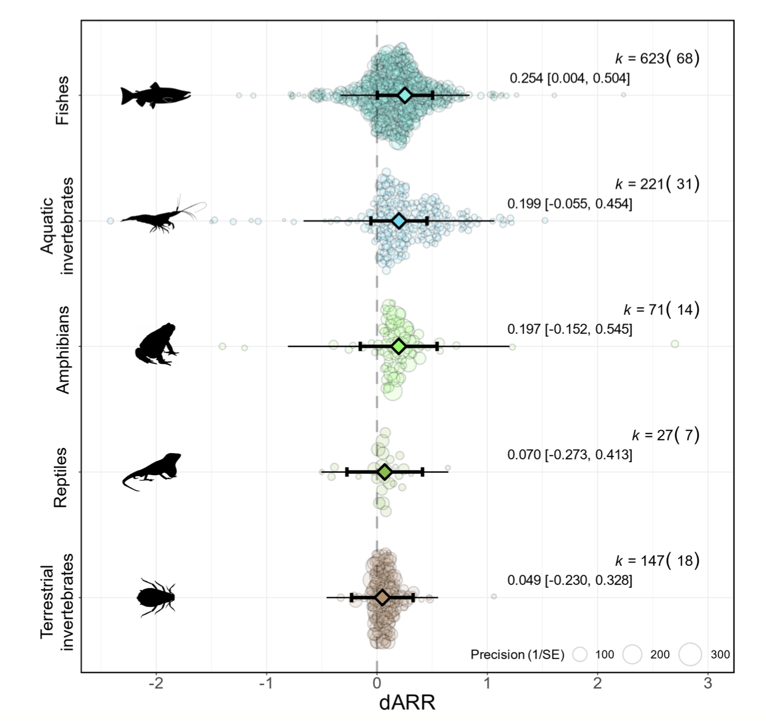
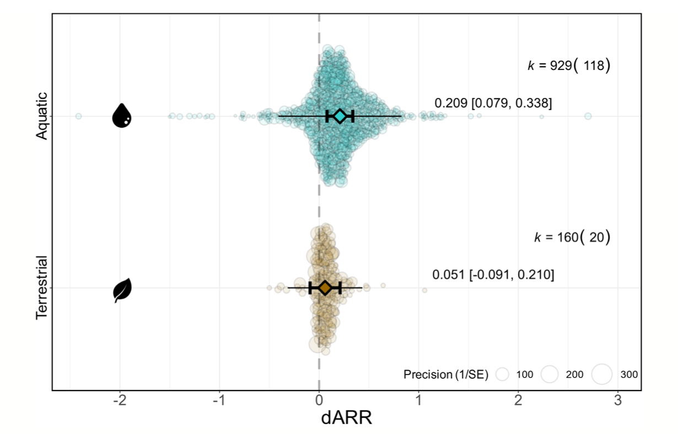
Biological Drivers…..
3. Meta-regression and Publication bias

Slide 18
Multilevel Meta-regression Model
3. Meta-regression and Publication bias
meta_reg <- metafor::rma.mv(yi= ARR ~ 1 + method + class, V = V_ARR, method="REML", random=list(~1|species_ID, ~1|study_ID, ~1|es_ID), dfs = "contain", test="t", data=asr_dat) ## ## Multivariate Meta-Analysis Model (k = 123; method: REML) ## ## Variance Components: ## ## estim sqrt nlvls fixed factor ## sigma^2.1 0.0009 0.0305 29 no species_ID ## sigma^2.2 0.0037 0.0605 21 no study_ID ## sigma^2.3 0.0105 0.1024 123 no es_ID ## ## Test for Residual Heterogeneity: ## QE(df = 115) = 898.2185, p-val < .0001 ## ## Test of Moderators (coefficients 2:8): ## F(df1 = 7, df2 = 13) = 4.0631, p-val = 0.0142 ## ## Model Results: ## ## estimate se tval df pval ci.lb ci.ub​ ## intrcpt 0.2953 0.0381 7.7505 13 <.0001 0.2130 0.3776 *** ## methodLTmax -0.0541 0.0569 -0.9507 115 0.3438 -0.1667 0.0586 ## classAmphibia -0.0312 0.1029 -0.3035 13 0.7663 -0.2534 0.1910 ## classArachnida -0.3432 0.1347 -2.5477 13 0.0243 -0.6341 -0.0522 * ## classChondrichthyes 0.0453 0.1113 0.4072 13 0.6905 -0.1951 0.2857 ## classInsecta -0.2331 0.0517 -4.5114 13 0.0006 -0.3447 -0.1215 *** ## classMalacostraca -0.1331 0.0598 -2.2271 13 0.0442 -0.2623 -0.0040 * ## classReptilia -0.2291 0.1071 -2.1393 13 0.0520 -0.4605 0.0023 . ## --- ## Signif. codes: 0 '***' 0.001 '**' 0.01 '*' 0.05 '.' 0.1 ' ' 1

Slide 19
Multilevel Meta-regression Model
3. Meta-regression and Publication bias
meta_reg <- metafor::rma.mv(yi= ARR ~ 1 + method + class, V = V_ARR, method="REML", random=list(~1|species_ID, ~1|study_ID, ~1|es_ID), dfs = "contain", test="t", data=asr_dat) ## ## Multivariate Meta-Analysis Model (k = 123; method: REML) ## ## Variance Components: ## ## estim sqrt nlvls fixed factor ## sigma^2.1 0.0009 0.0305 29 no species_ID ## sigma^2.2 0.0037 0.0605 21 no study_ID ## sigma^2.3 0.0105 0.1024 123 no es_ID ## ## Test for Residual Heterogeneity: ## QE(df = 115) = 898.2185, p-val < .0001 ## ## Test of Moderators (coefficients 2:8): ## F(df1 = 7, df2 = 13) = 4.0631, p-val = 0.0142 ## ## Model Results: ## ## estimate se tval df pval ci.lb ci.ub​ ## intrcpt 0.2953 0.0381 7.7505 13 <.0001 0.2130 0.3776 *** ## methodLTmax -0.0541 0.0569 -0.9507 115 0.3438 -0.1667 0.0586 ## classAmphibia -0.0312 0.1029 -0.3035 13 0.7663 -0.2534 0.1910 ## classArachnida -0.3432 0.1347 -2.5477 13 0.0243 -0.6341 -0.0522 * ## classChondrichthyes 0.0453 0.1113 0.4072 13 0.6905 -0.1951 0.2857 ## classInsecta -0.2331 0.0517 -4.5114 13 0.0006 -0.3447 -0.1215 *** ## classMalacostraca -0.1331 0.0598 -2.2271 13 0.0442 -0.2623 -0.0040 * ## classReptilia -0.2291 0.1071 -2.1393 13 0.0520 -0.4605 0.0023 . ## --- ## Signif. codes: 0 '***' 0.001 '**' 0.01 '*' 0.05 '.' 0.1 ' ' 1
F-test indicates moderators explain significant variation in female ARR

Slide 20
Multilevel Meta-regression Model
3. Meta-regression and Publication bias
meta_reg <- metafor::rma.mv(yi= ARR ~ 1 + method + class, V = V_ARR, method="REML", random=list(~1|species_ID, ~1|study_ID, ~1|es_ID), dfs = "contain", test="t", data=asr_dat) ## ## Multivariate Meta-Analysis Model (k = 123; method: REML) ## ## Variance Components: ## ## estim sqrt nlvls fixed factor ## sigma^2.1 0.0009 0.0305 29 no species_ID ## sigma^2.2 0.0037 0.0605 21 no study_ID ## sigma^2.3 0.0105 0.1024 123 no es_ID ## ## Test for Residual Heterogeneity: ## QE(df = 115) = 898.2185, p-val < .0001 ## ## Test of Moderators (coefficients 2:8): ## F(df1 = 7, df2 = 13) = 4.0631, p-val = 0.0142 ## ## Model Results: ## ## estimate se tval df pval ci.lb ci.ub​ ## intrcpt 0.2953 0.0381 7.7505 13 <.0001 0.2130 0.3776 *** ## methodLTmax -0.0541 0.0569 -0.9507 115 0.3438 -0.1667 0.0586 ## classAmphibia -0.0312 0.1029 -0.3035 13 0.7663 -0.2534 0.1910 ## classArachnida -0.3432 0.1347 -2.5477 13 0.0243 -0.6341 -0.0522 * ## classChondrichthyes 0.0453 0.1113 0.4072 13 0.6905 -0.1951 0.2857 ## classInsecta -0.2331 0.0517 -4.5114 13 0.0006 -0.3447 -0.1215 *** ## classMalacostraca -0.1331 0.0598 -2.2271 13 0.0442 -0.2623 -0.0040 * ## classReptilia -0.2291 0.1071 -2.1393 13 0.0520 -0.4605 0.0023 . ## --- ## Signif. codes: 0 '***' 0.001 '**' 0.01 '*' 0.05 '.' 0.1 ' ' 1
Studies quantifying female thermal tolerance using LT_{max} decreases ARR, on average, by 0.054℃ compared to those measuring thermal tolerance with CT_{max}, but this is not significantly different from 0

Slide 21
Multilevel Meta-regression Model
3. Meta-regression and Publication bias
meta_reg <- metafor::rma.mv(yi= ARR ~ 1 + method + class, V = V_ARR, method="REML", random=list(~1|species_ID, ~1|study_ID, ~1|es_ID), dfs = "contain", test="t", data=asr_dat) ## ## Multivariate Meta-Analysis Model (k = 123; method: REML) ## ## Variance Components: ## ## estim sqrt nlvls fixed factor ## sigma^2.1 0.0009 0.0305 29 no species_ID ## sigma^2.2 0.0037 0.0605 21 no study_ID ## sigma^2.3 0.0105 0.1024 123 no es_ID ## ## Test for Residual Heterogeneity: ## QE(df = 115) = 898.2185, p-val < .0001 ## ## Test of Moderators (coefficients 2:8): ## F(df1 = 7, df2 = 13) = 4.0631, p-val = 0.0142 ## ## Model Results: ## ## estimate se tval df pval ci.lb ci.ub​ ## intrcpt 0.2953 0.0381 7.7505 13 <.0001 0.2130 0.3776 *** ## methodLTmax -0.0541 0.0569 -0.9507 115 0.3438 -0.1667 0.0586 ## classAmphibia -0.0312 0.1029 -0.3035 13 0.7663 -0.2534 0.1910 ## classArachnida -0.3432 0.1347 -2.5477 13 0.0243 -0.6341 -0.0522 * ## classChondrichthyes 0.0453 0.1113 0.4072 13 0.6905 -0.1951 0.2857 ## classInsecta -0.2331 0.0517 -4.5114 13 0.0006 -0.3447 -0.1215 *** ## classMalacostraca -0.1331 0.0598 -2.2271 13 0.0442 -0.2623 -0.0040 * ## classReptilia -0.2291 0.1071 -2.1393 13 0.0520 -0.4605 0.0023 . ## --- ## Signif. codes: 0 '***' 0.001 '**' 0.01 '*' 0.05 '.' 0.1 ' ' 1
Compared to CT_{max} studies on Actinopterygii we see that there are significantly smaller mean female ARR in Arachnida, Malacostraca and Insecta. Reptiles also have a smaller ARR compared to Actinopterygii by this is not significant at alpha = 0.05.

Slide 22
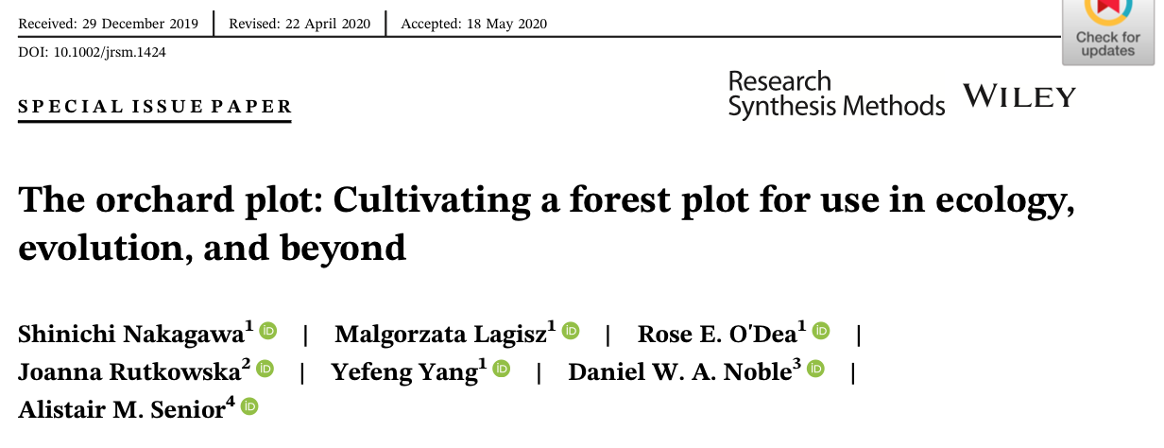
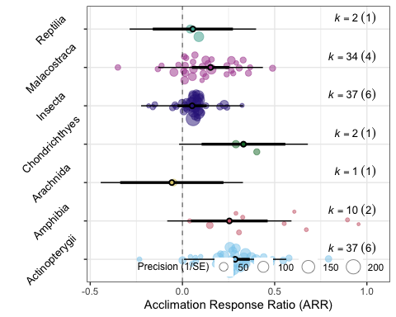
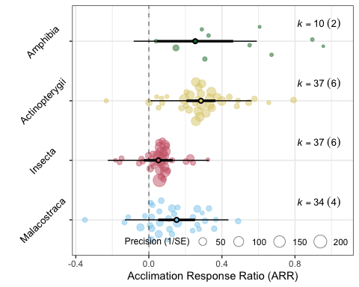
Orchard plots
3. Meta-regression and Publication bias
mod_table <- orchaRd::mod_results(meta_reg, data = asr_dat, mod = "class", group = "study_ID", at = list(class = c("Malacostraca", "Insecta", "Actinopterygii", "Amphibia")), subset = TRUE) orchaRd::orchard_plot(mod_table, xlab = "Acclimation Response Ratio (ARR)", angle = 45)
orchaRd::orchard_plot(meta_reg, data = asr_dat, mod = "class", group = "study_ID", xlab = "Acclimation Response Ratio (ARR)", angle = 45)

Slide 23
We found variation (a lot)! Now what? Multilevel Meta-regression
3. Meta-regression and Publication bias
Heterogeneity in meta-analyses is HIGH!
Now we have identified so much of it the next major goal is to explain what drives effect size variability?
Methodological
Experimental, observational, dosages, temperatures?
Biological
Body size of species, latitude, foraging mode, thermoregulatory strategies
Publication biases!

Slide 24





Publication bias
3. Meta-regression and Publication bias
Massively important topic because meta-analysis relies on the sample of studies being random
Huge number of tools, both visual and analytical, have been developed to try and identify and correct bias
Notes:
https://www.youtube.com/watch?v=BNICMrYtPJY
https://www.sciencedirect.com/science/article/abs/pii/S0169534701022352

Slide 25
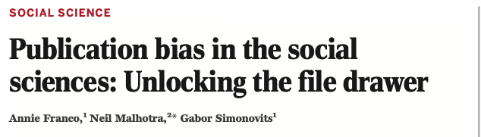
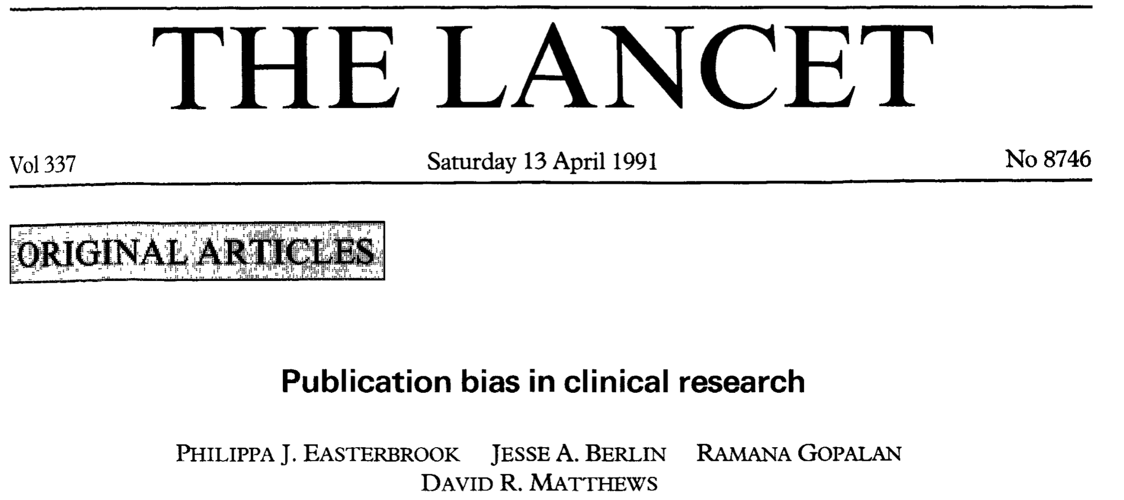
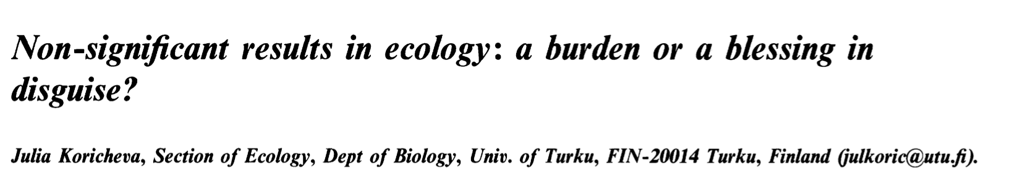
How do we know these biases exist?
3. Meta-regression and Publication bias
Strong results are 40% more likely to be published than ‘null’ results; 60% more likely to be written up!
285 studies (52% published) showed published more more likely to show statistically significant results
Maybe Ecology is better??
Significant and non-significant results were about equal in published and unpublished thesis chapters

Slide 26
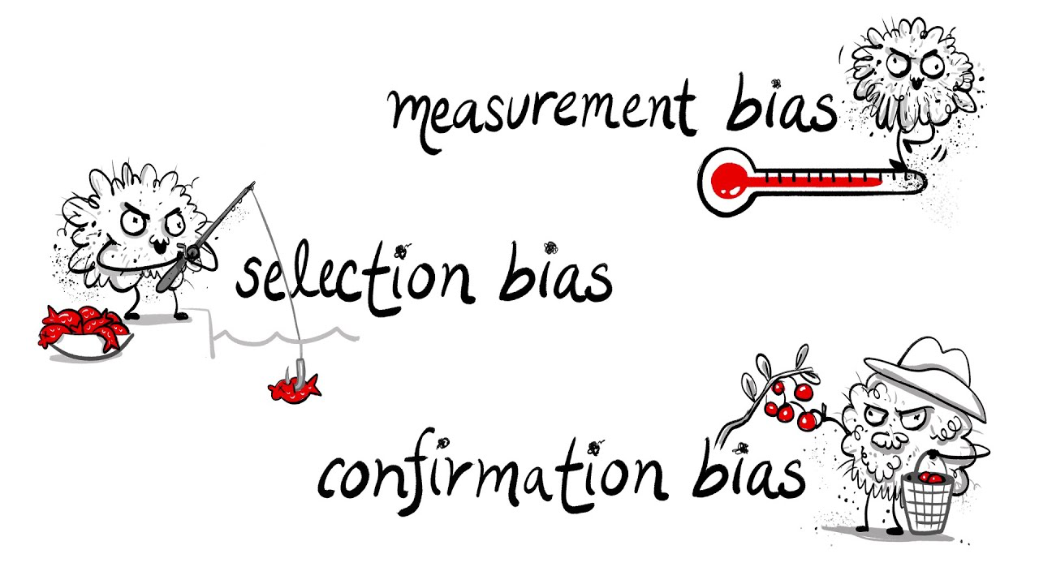

Publication bias
3. Meta-regression and Publication bias
Effect size heterogeneity can also be driven by biases in publishing practices in the literature
Publication bias: “bias owing to the influence of research findings on submission, reviews and editorial decisions” (Møller & Jennions 2001)
Bias can result from:
Non-significant results going unpublished (‘file-drawer’ problem)
‘p-hacking’
Time-lag bias
Notes:
https://www.youtube.com/watch?v=BNICMrYtPJY
https://www.sciencedirect.com/science/article/abs/pii/S0169534701022352

Slide 27
Publication bias
3. Meta-regression and Publication bias
Effect size heterogeneity can also be driven by biases in publishing practices in the literature
Publication bias: “bias owing to the influence of research findings on submission, reviews and editorial decisions” (Møller & Jennions 2001)
Bias can result from:
Non-significant results going unpublished (‘file-drawer’ problem)
‘p-hacking’
Time-lag bias
Notes:
https://www.youtube.com/watch?v=BNICMrYtPJY
https://www.sciencedirect.com/science/article/abs/pii/S0169534701022352

Slide 28
3. Meta-regression and Publication bias
Publication bias
Two major goals:
Identifying publication bias
Correcting for publication bias
Various graphical approaches:
Funnel Plots
Trim and Fill
Radial plots
‘p-curves’
Various Analytical Approaches
Meta-regression
Egger’s regression
Selection models

Slide 29
3. Meta-regression and Publication bias
Publication bias
Two major goals:
Identifying publication bias
Correcting for publication bias
Various graphical approaches:
Funnel Plots
Trim and Fill
Radial plots
‘p-curves’
Various Analytical Approaches
Meta-regression
Egger’s regression
Selection models

Slide 30
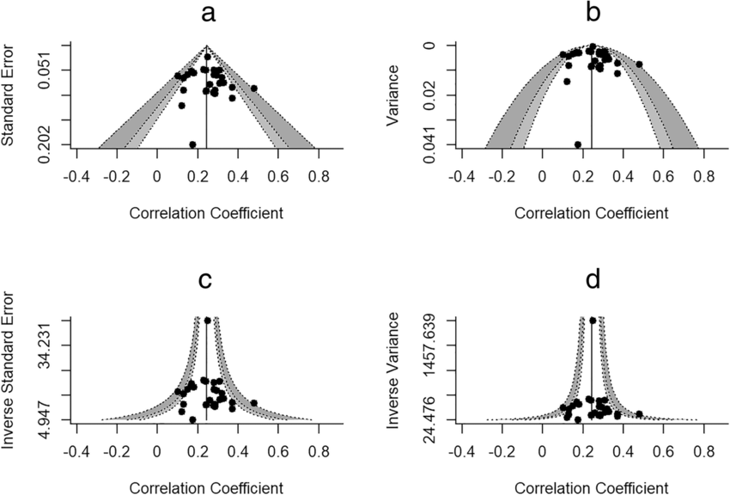
3. Meta-regression and Publication bias
Publication bias
Two major goals:
Identifying publication bias
Correcting for publication bias
Various graphical approaches:
Funnel Plots
Trim and Fill
Radial plots
‘p-curves’
Various Analytical Approaches
Meta-regression
Egger’s regression
Selection models

Slide 31
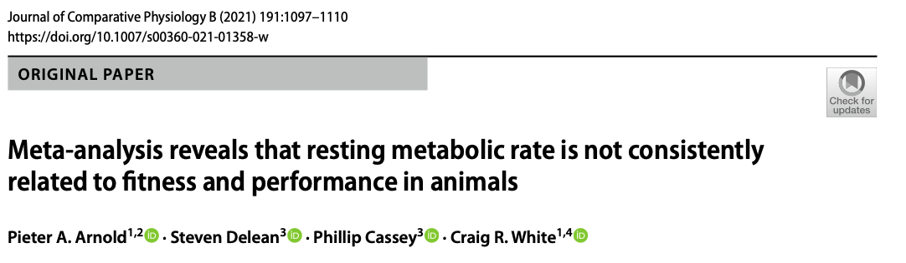
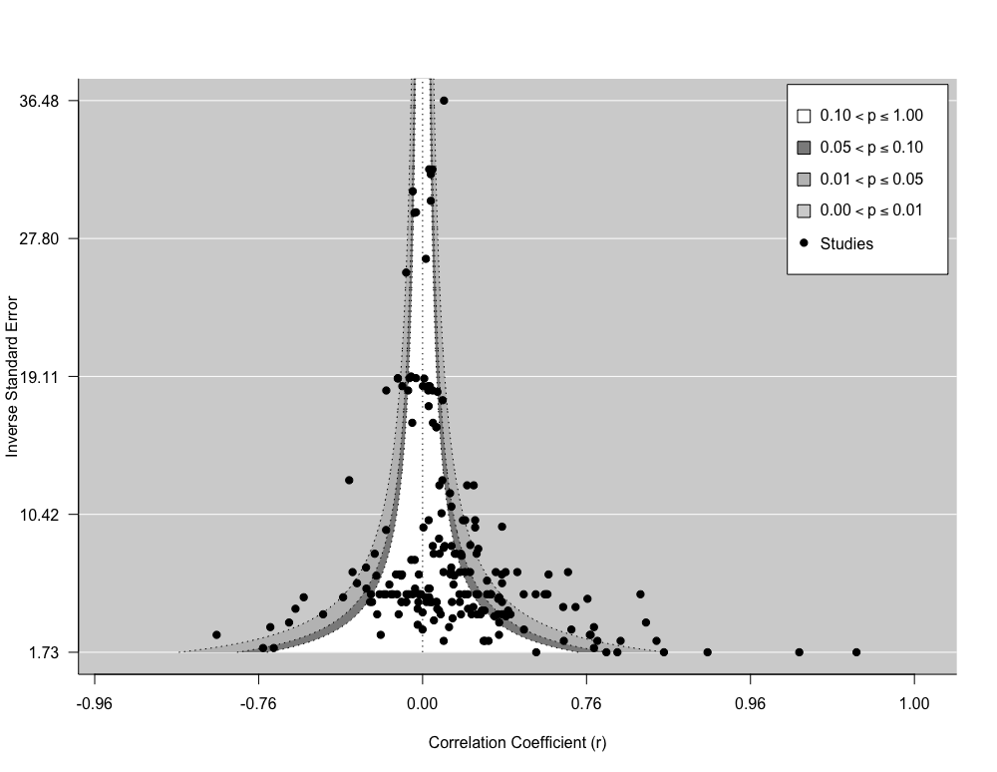
3. Meta-regression and Publication bias
Funnel plots
metafor::funnel(x = arnold_data_endo$Zr, vi = arnold_data_endo$Zr_v, yaxis = "seinv", digits = 2, level = c(0.1, 0.05, 0.01), shade = c("white", "gray55", "gray 75"), las = 1, xlab = "Correlation Coefficient (r)", atransf = tanh, legend = TRUE)

Slide 32
3. Meta-regression and Publication bias
Funnel plots
What would we expect publication bias to look like and why?

Slide 33
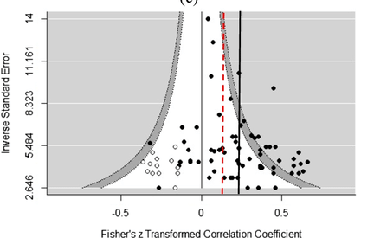
3. Meta-regression and Publication bias
Publication bias
Two major goals:
Identifying publication bias
Correcting for publication bias
Various graphical approaches:
Funnel Plots
Trim and Fill
Radial plots
‘p-curves’
Various Analytical Approaches
Meta-regression
Egger’s regression
Selection models

Slide 34
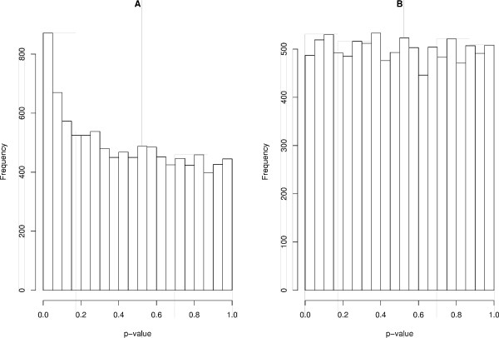
3. Meta-regression and Publication bias
Publication bias
Two major goals:
Identifying publication bias
Correcting for publication bias
Various graphical approaches:
Funnel Plots
Trim and Fill
Radial plots
‘p-curves’
Various Analytical Approaches
Meta-regression
Egger’s regression
Selection models

Slide 35
3. Meta-regression and Publication bias
Publication bias
Two major goals:
Identifying publication bias
Correcting for publication bias
Various graphical approaches:
Funnel Plots
Trim and Fill
Radial plots
‘p-curves’
Various Analytical Approaches
Meta-regression
Egger’s regression
Selection models
Which distribution is from the null?

Slide 36

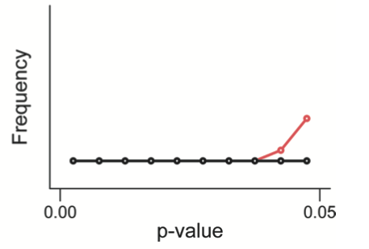
3. Meta-regression and Publication bias
Researchers collect or select data or statistical analyses until non-significant results become significant
Assume no effect (i.e., null)
Notes:
https://www.youtube.com/watch?v=BNICMrYtPJY
https://www.sciencedirect.com/science/article/abs/pii/S0169534701022352

Slide 37
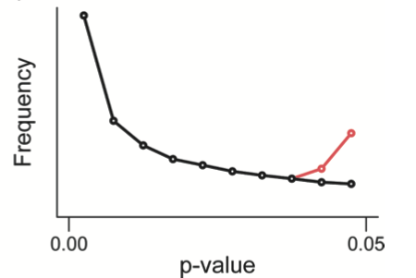
3. Meta-regression and Publication bias
Researchers collect or select data or statistical analyses until non-significant results become significant
Assume effect exists (i.e., alternative)
Notes:
https://www.youtube.com/watch?v=BNICMrYtPJY
https://www.sciencedirect.com/science/article/abs/pii/S0169534701022352

Slide 38
3. Meta-regression and Publication bias
Publication bias
Two major goals:
Identifying publication bias
Correcting for publication bias
Various graphical approaches:
Funnel Plots
Trim and Fill
Radial plots
‘p-curves’
Various Analytical Approaches
Meta-regression
Egger’s regression
Selection models

Slide 39
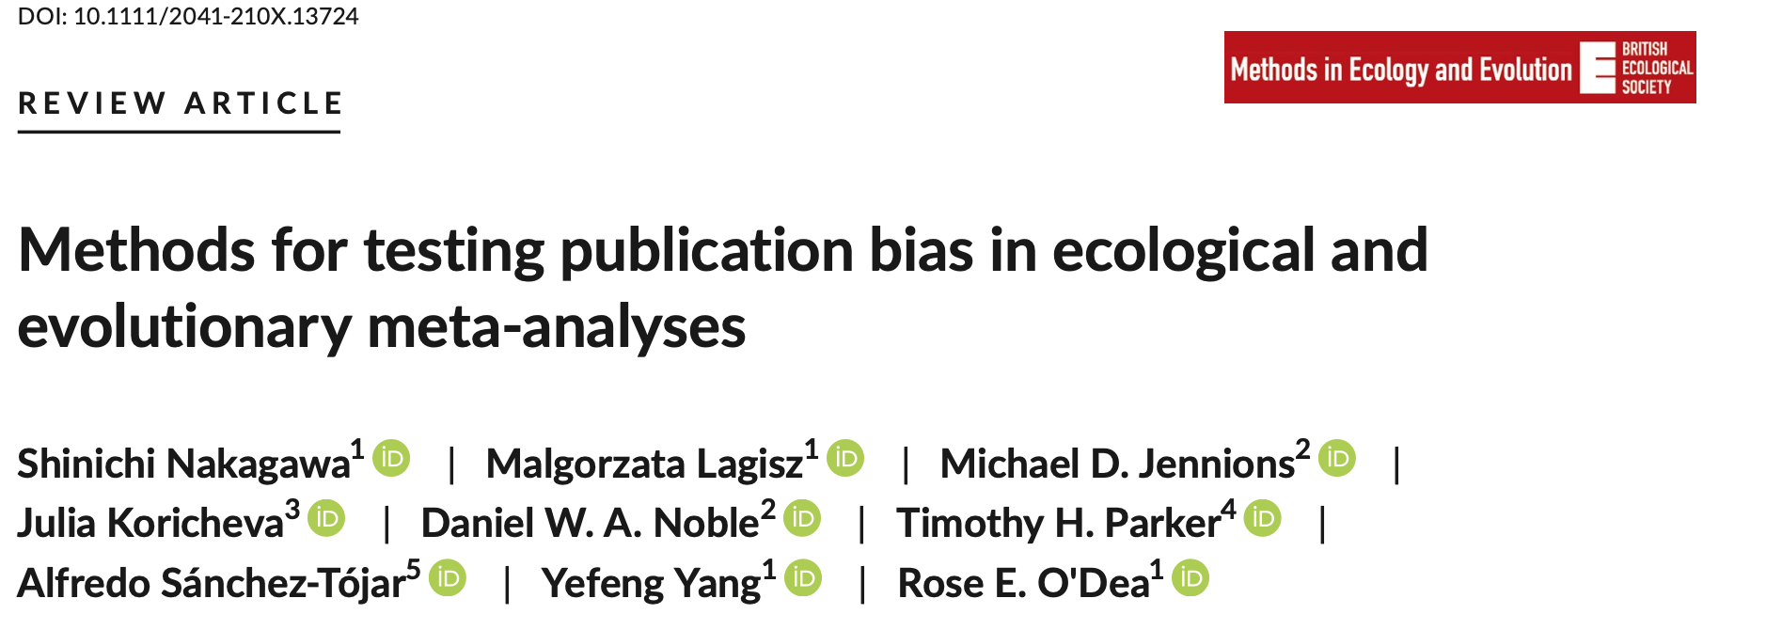
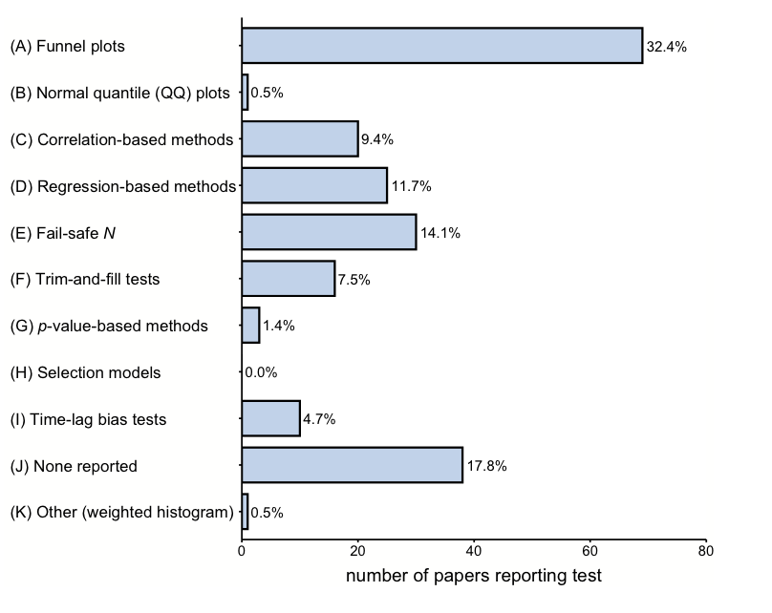
3. Meta-regression and Publication bias
Publication bias
Two major goals:
Identifying publication bias
Correcting for publication bias
Various graphical approaches:
Funnel Plots
Trim and Fill
Radial plots
‘p-curves’
Various Analytical Approaches
Meta-regression
Egger’s regression
Selection models

Slide 40
3. Meta-regression and Publication bias
Publication bias
Two major goals:
Identifying publication bias
Correcting for publication bias
Various graphical approaches:
Funnel Plots
Trim and Fill
Radial plots
‘p-curves’
Various Analytical Approaches
Meta-regression
Egger’s regression
Selection models

Slide 41
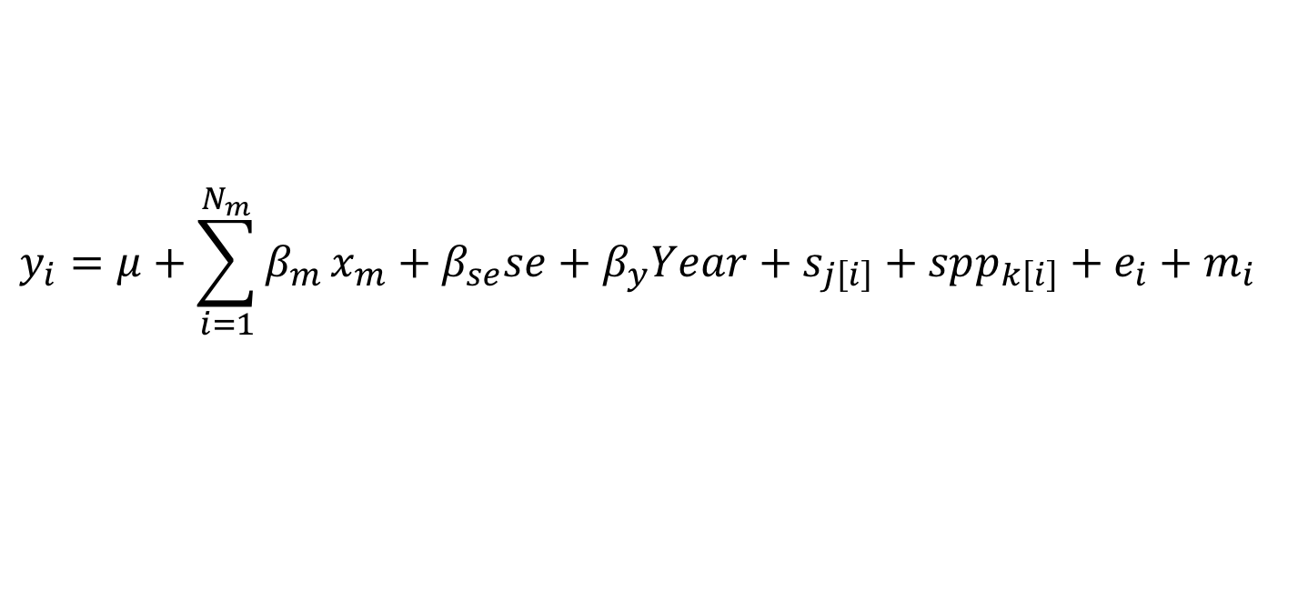
3. Meta-regression and Publication bias
Multi-level Meta-regression
Publication bias - ‘The file-drawer’
SE or V as moderator in analysis (depending on whether intercept is significant) (Nakagawa et al. 2022)
Explicit inferential test for publication bias
Can correct meta-analytic mean (intercept) for when ‘no sampling error exists’
Time-lag bias
Initial results are inflated, usually lower powered, and over time effects converge on ‘true’ effect
Cumulative meta-analysis

Slide 42
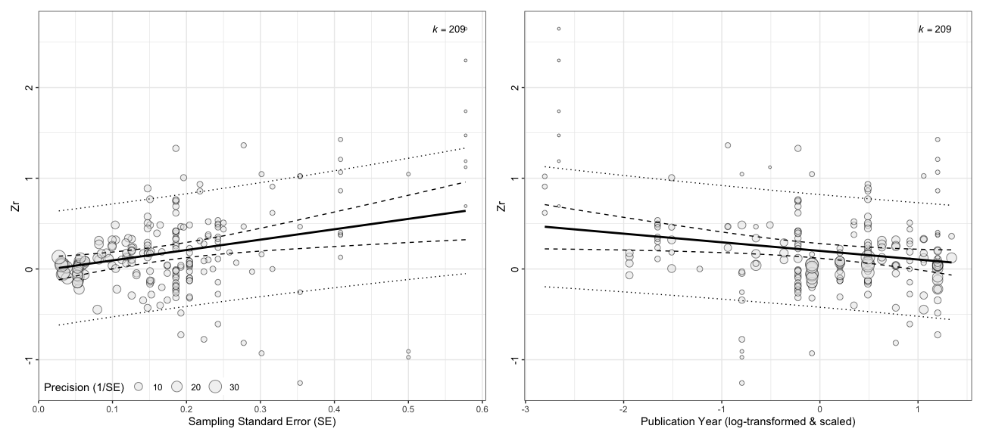
3. Meta-regression and Publication bias
Multi-level Meta-regression
# Bubble plots! p1 <- orchaRd::bubble_plot(metareg_se_time, mod = "se", group = "Ref", data = arnold_data_endo, xlab = "Sampling Standard Error (SE)", ylab = "Zr”, legend.pos = ”bottom.left")

Slide 43
3. Meta-regression and Publication bias
Multi-level Meta-regression
# Including sampling standard error as moderator metareg_se <- rma.mv(Zr ~ sqrt(Zr_v), V = Zr_v, test = "t", dfs = "contain", data = arnold_data_endo, random = list(~1|Ref, ~1|obs)) summary(metareg_se)
## ## Multivariate Meta-Analysis Model (k = 209; method: REML) ## ## logLik Deviance AIC BIC AICc ​ ## -77.9464 155.8928 163.8928 177.2237 164.0908 ## ## Variance Components: ## ## estim sqrt nlvls fixed factor ## sigma^2.1 0.0626 0.2503 62 no Ref ## sigma^2.2 0.0380 0.1951 209 no obs ## … ## Model Results: ## ## estimate se tval df pval ci.lb ci.ub ​ ## intrcpt -0.0668 0.0727 -0.9184 60 0.3621 -0.2122 0.0787 ## sqrt(Zr_v) 1.3908 0.3674 3.7857 207 0.0002 0.6665 2.1151 *** ## ## --- ## Signif. codes: 0 '***' 0.001 '**' 0.01 '*' 0.05 '.' 0.1 ' ' 1

Slide 44
3. Meta-regression and Publication bias
Multi-level Meta-regression
Publication bias - ‘The file-drawer’
SE or V as moderator in analysis (depending on whether intercept is significant) (Nakagawa et al. 2022)
Explicit inferential test for publication bias
Can correct meta-analytic mean (intercept) for when ‘no sampling error exists’
Time-lag bias
Initial results are inflated, usually lower powered, and over time effects converge on ‘true’ effect
If time-lag bias exists what would we predict if we included ‘year’ as a fixed effect (moderator) in the meta-regression model?

Slide 45
3. Meta-regression and Publication bias
Multi-level Meta-regression
# Bubble plots! p1 <- orchaRd::bubble_plot(metareg_se_time, mod = "se", group = "Ref", data = arnold_data_endo, xlab = "Sampling Standard Error (SE)", ylab = "Zr”, legend.pos = ”bottom.left") p2 <- orchaRd::bubble_plot(metareg_se_time, mod = "c_log_year", group = "Ref", data = arnold_data_endo, xlab = "Publication Year (log-transformed & scaled)", ylab = "Zr”, legend.pos = ”none")

Slide 46
3. Meta-regression and Publication bias
Multi-level Meta-regression
# Including sampling standard error as moderator and year arnold_data_endo$se <- sqrt(arnold_data_endo$Zr_v) arnold_data_endo$c_log_year <- scale(log(arnold_data_endo$Year)) # Fit model metareg_se_time <- rma.mv(Zr ~ se + log_year, V = Zr_v, test = "t", dfs = "contain", data = arnold_data_endo, random = list(~1|Ref, ~1|obs)) summary(metareg_se_time)
## ## Multivariate Meta-Analysis Model (k = 209; method: REML) ## ## logLik Deviance AIC BIC AICc ​ ## -74.9818 149.9636 159.9636 176.6030 160.2636 ## ## Variance Components ## estim sqrt nlvls fixed factor ## sigma^2.1 0.0569 0.2385 62 no Ref ## sigma^2.2 0.0376 0.1940 209 no obs ## … ## Model Results: ## ## estimate se tval df pval ci.lb ci.ub ​ ## intrcpt -0.0202 0.0733 -0.2757 59 0.7837 -0.1669 0.1265 ## se 1.1444 0.3734 3.0644 206 0.0025 0.4081 1.8806 ** ## log_year -0.0949 0.0408 -2.3251 59 0.0235 -0.1765 -0.0132 * ## Signif. codes: 0 '***' 0.001 '**' 0.01 '*' 0.05 '.' 0.1 ' ' 1

